Slide 1
Out of lesson work
Year 10
Term 1
Band 1-2: Page 2-28
Band 2-4: Page 29-61
Band 3-5: Page 62- 89
Band 4-7: Page 90-119
Band 6-9: Page 120-147

Slide 2
Week 2

Slide 3
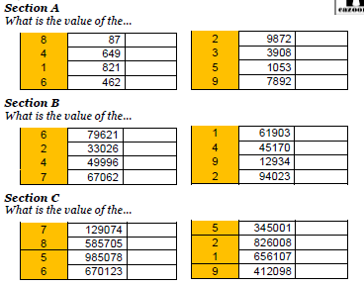
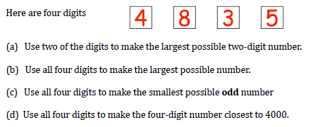
Year 10 Inclusion work week 2 Term 1
Number Basics
1 | Twenty two thousand four hundred and fifty three | 22453
2 | Forty three thousand two hundred and seventeen
3 | Seventy thousand three hundred and twenty seven
4 | Five hundred and forty three thousand and fifty nine
5 | Seven hundred and sixty eight thousand four hundred and one
6 | Seventeen thousand and fifty
7 | Nine hundred thousand two hundred and fifty four
8 | Eight hundred thousand and seven

Slide 4
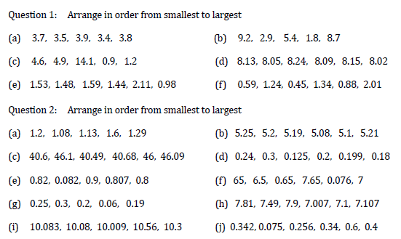
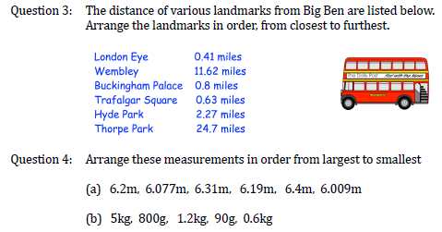
Year 10 Inclusion work week 2 Term 1
Number Basics 2

Slide 5
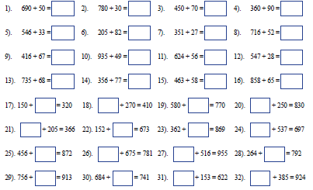
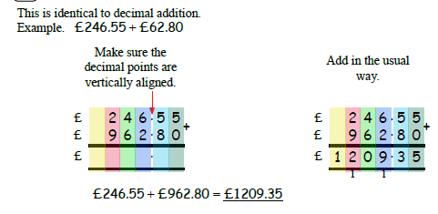
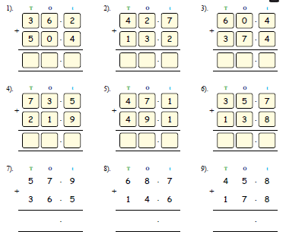
Year 10 Inclusion work week 2 Term 1
Addition

Slide 6
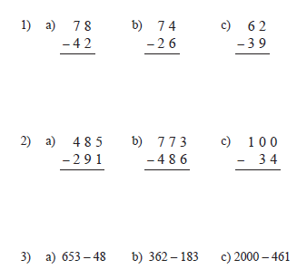
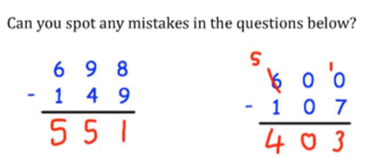
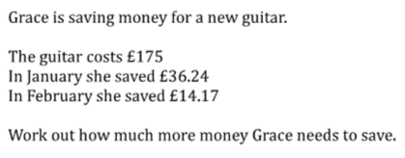
Year 10 Inclusion work week 2 Term 1
Subtraction

Slide 7
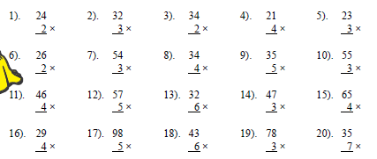
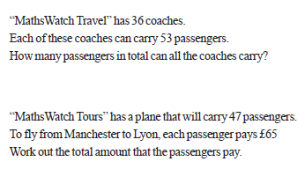
Year 10 Inclusion work week 2 Term 1
Long Multiplication

Slide 8
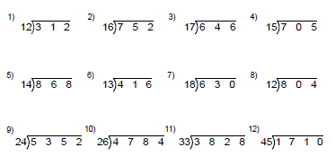
Year 10 Inclusion work week 2 Term 1
Long Division

Slide 9
Week 3

Slide 10
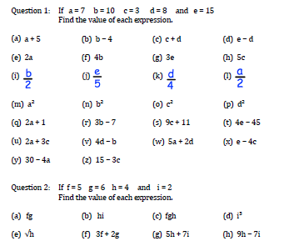
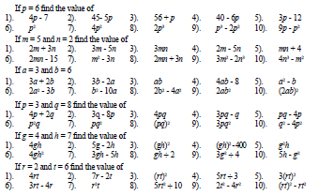
Year 10 Inclusion work week 3 Term 1
Substitution

Slide 11
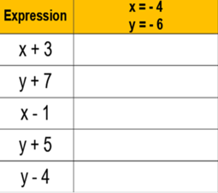
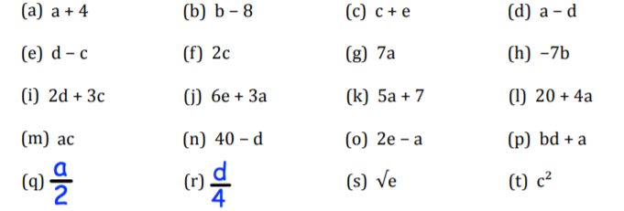
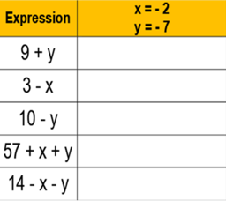
Year 10 Inclusion work week 3 Term 1
Substitution with Negatives

Slide 12
Week 4

Slide 13
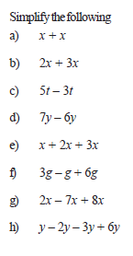
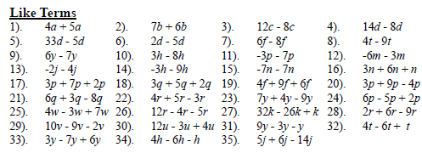
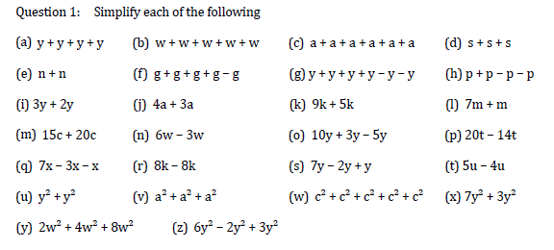
Year 10 Inclusion work week 4 Term 1
Collecting Like Terms

Slide 14
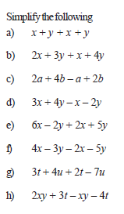
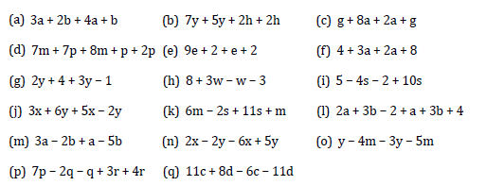
Year 10 Inclusion work week 4 Term 1
Simplifying Expressions

Slide 15
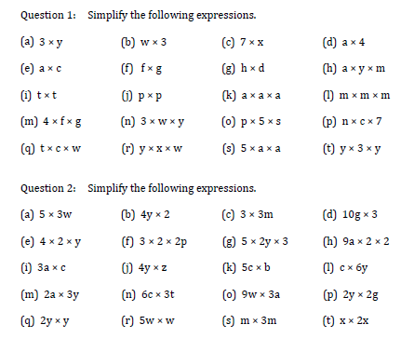
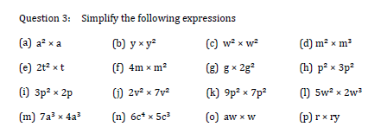
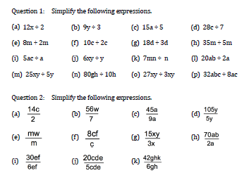
Year 10 Inclusion work week 4 Term 1
Simplifying Expressions (Multiply/Divide)

Slide 16
Week 5

Slide 17
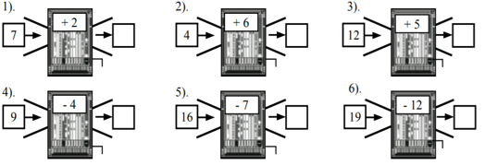
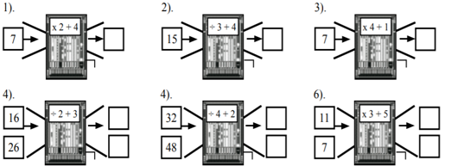
Year 10 Inclusion work week 5 Term 1
Function Machines (Output)

Slide 18
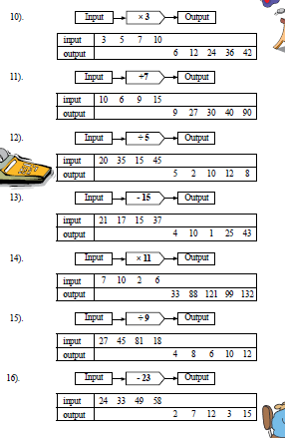
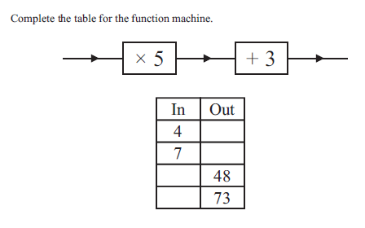
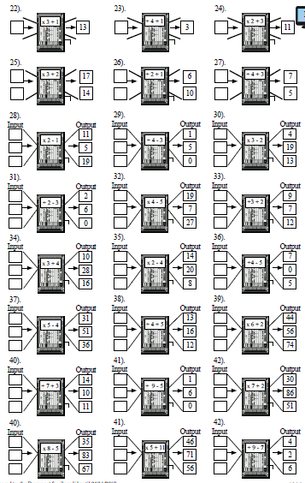
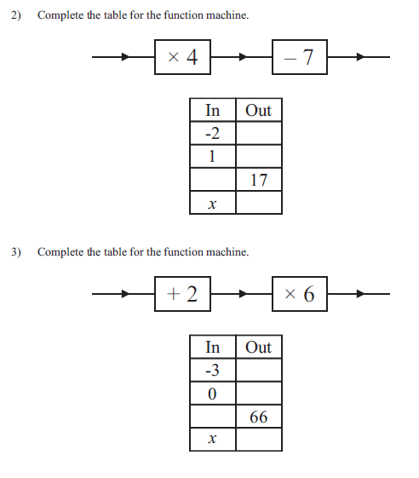
Year 10 Inclusion work week 5 Term 1
Function Machines (Input)

Slide 19
Week 6

Slide 20
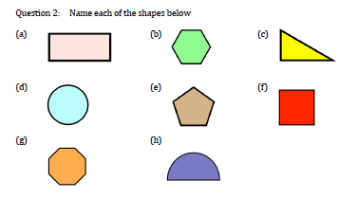
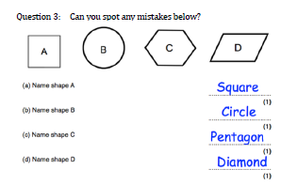
Year 10 Inclusion work week 6 Term 1
Shapes
Question 1 : Draw the following shapes
a) A square b) A rectangle c) A circle d) A triangle
e) A semi-circle f) A pentagon g) An octagon h) A hexagon
i) A decagon j) A heptagon
Draw 4 different hexagons
Name shape A
Name shape B
Name shape C
Name shape D

Slide 21
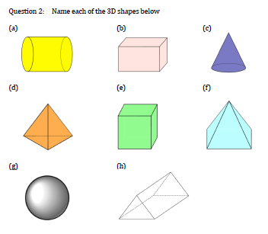
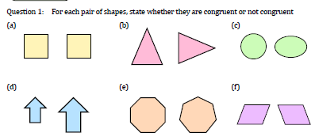
Year 10 Inclusion work week 6 Term 1
Shapes- lesson 2
Draw the following 3D shapes
A cube b) A cuboid c) A sphere
d) A cylinder e) A triangular prism f) A cone
g) A square-based pyramid
For each pair of shapes, state whether they are congruent or not congruent

Slide 22
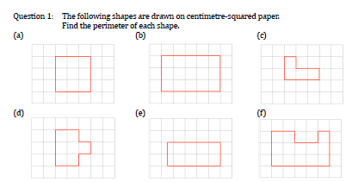
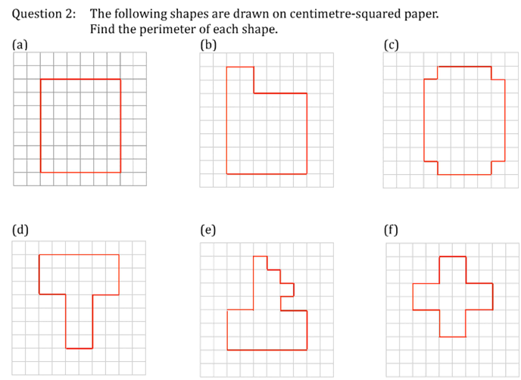
Year 10 Inclusion work week 6 Term 1
Perimeter- Counting squares
The following shapes are drawn on centimetre-square paper.
Find the perimeter of each shape
The following shapes are drawn on centimetre-square paper.
Find the perimeter of each shape

Slide 23
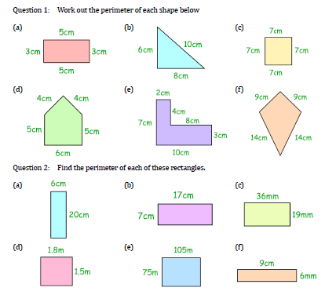
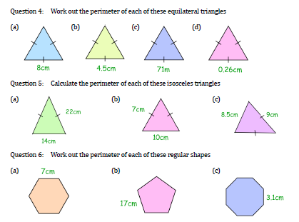
Year 10 Inclusion work week 6 Term 1
Perimeter
Work out the perimeter of each of the following shapes

Slide 24
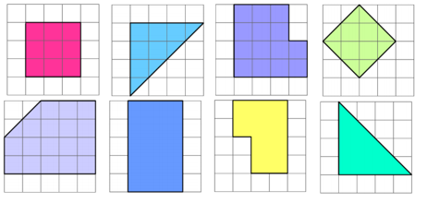
Year 10 Inclusion work week 6 Term 1
Area
Work out the area of each of he shapes below

Slide 25
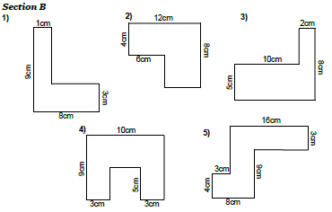
Year 10 Inclusion work week 6 Term 1
Area
Work out the area of each of he shapes below

Slide 26
Week 7

Slide 27
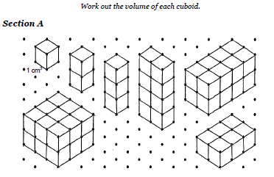
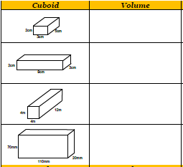
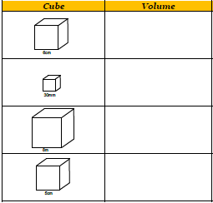
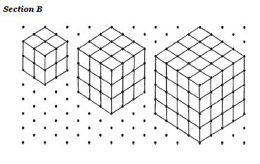
Year 10 Inclusion work week 7 Term 1
Volume

Slide 28
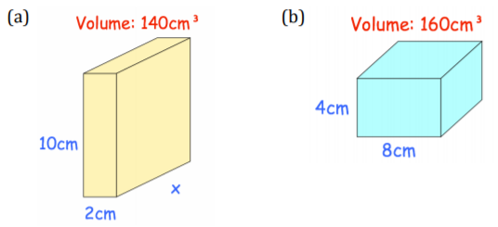
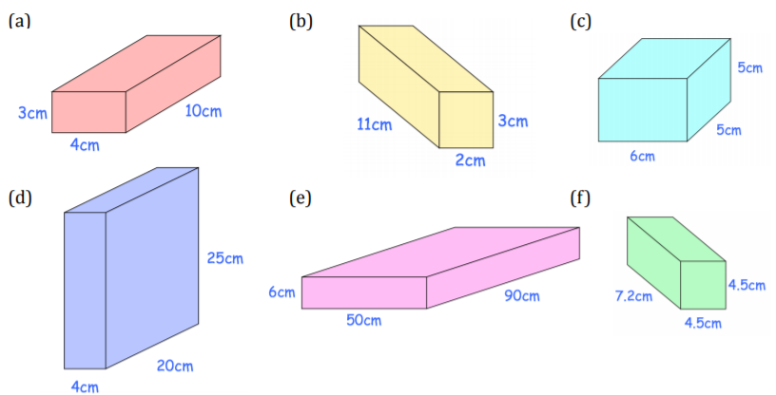
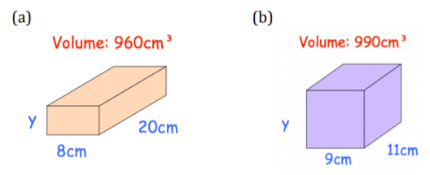
Year 10 Inclusion work week 7 Term 1
Volume- lesson 2
Find x
Find y
Find the volume of each of the following cuboids:

Slide 29
Out of lesson work
Year 10
Term 1
Band 2-4

Slide 30
Week 2

Slide 31
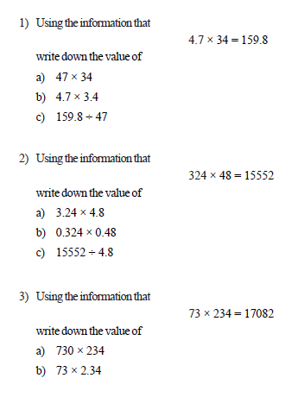
Year 10 Inclusion work week 2 Term 1
Number Basics
1 | Twenty two thousand four hundred and fifty three | 22453
2 | Forty three thousand two hundred and seventeen
3 | Seventy thousand three hundred and twenty seven
4 | Five hundred and forty three thousand and fifty nine
5 | Seven hundred and sixty eight thousand four hundred and one
6 | Seventeen thousand and fifty
7 | Nine hundred thousand two hundred and fifty four
8 | Eight hundred thousand and seven

Slide 32
Year 10 Inclusion work week 2 Term 1
Addition & Subtraction

Slide 33
Year 10 Inclusion work week 2 Term 1
Multiplication & Division

Slide 34
Year 10 Inclusion work week 2 Term 1
Long Multiplication

Slide 35
Year 10 Inclusion work week 2 Term 1
Long Division
Work out the answers to following divisions
84 ÷ 4 b) 52 ÷ 2 c) 72 ÷ 3 d) 75 ÷ 5
e) 54 ÷ 3 f) 68 ÷ 4 g) 90 ÷ 5 h) 84 ÷ 6
i) 91 ÷ 7 j) 81 ÷ 3 k) 87 ÷ 3 dl 92 ÷ 4

Slide 36
Week 3

Slide 37
Year 10 Inclusion work week 3 Term 1
Types of Number
Work out each of the following
a) $\sqrt{9}$ b) $\sqrt{25}$ c) $\sqrt{100}$d) $\sqrt{4}$ e) $\sqrt{36}$ f) $\sqrt{144}$
Work out each of the following
a) $\sqrt[3]{8}$ b) $\sqrt[3]{27}$ c) $\sqrt[3]{125}$ d)$\sqrt[3]{64}$ e) $\sqrt[3]{1}$ f)$\sqrt[3]{1000}$

Slide 38
Year 10 Inclusion work week 3 Term 1
Multiples & Factors
Find the highest common factor of :
a) 20 and 15 b) 32 and 48 c) 36 and 60
d) 44 and 66 e) 27 and 72 f) 32 and 40
g) 40 and 48 h) 40 and 60 i) 84 and 210
Find the lowest common multiple of :
a) 4 and 6 b) 8 and 10 c) 5 and 6
d) 8 and 12 e) 6 and 14 f) 15 and 20
g) 12 and 15 h) 40 and 60 i) 10 and 25

Slide 39
Year 10 Inclusion work week 3 Term 1
Prime Numbers
Prime factors

Slide 40
Year 10 Inclusion work week 3 Term 1
Substitution

Slide 41
Year 10 Inclusion work week 3 Term 1
Substitution with Negatives

Slide 42
Year 10 Inclusion work week 3 Term 1
Substitution to Solve
Use trial and improvement to find an approximate solutions of an equations. There must be a trial at 2dp to decide which 1dp answer it is.

Slide 43
Week 4

Slide 44
Year 10 Inclusion work week 4 Term 1
Collecting Like Terms

Slide 45
Year 10 Inclusion work week 4 Term 1
Simplifying Expressions

Slide 46
Year 10 Inclusion work week 4 Term 1
Expanding Single Brackets

Slide 47
Year 10 Inclusion work week 5 Term 1
Expanding & Simplify Brackets
Extension

Slide 48
Year 10 Inclusion work week 4 Term 1
Factorising Expressions

Slide 49
Week 5

Slide 50
Year 10 Inclusion work week 5 Term 1
Function Machines (Output)

Slide 51
Year 10 Inclusion work week 5 Term 1
Function Machines (Input)

Slide 52
Year 10 Inclusion work week 5 Term 1
Solving Equations

Slide 53
Week 6

Slide 54
Year 10 Inclusion work week 6 Term 1
Shape, Perimeter & Area
For each pair of shapes, state whether they are congruent or not congruent
Question 1 : Draw the following shapes
a) A square b) A rectangle c) A circle d) A triangle
e) A semi-circle f) A pentagon g) An octagon h) A hexagon
i) A decagon j) A heptagon
Name each of the following 3D shapes

Slide 55
Year 10 Inclusion work week 6 Term 1
Shape, Perimeter & Area- lesson 2
The following shapes are drawn on centimetre-square paper.
Find the perimeter of each shape
Work out the perimeter of each shape below

Slide 56
Year 10 Inclusion work week 6 Term 1
Area
Work out the area of the following:
Work out the area of the following:
Work out the area of the following:
Work out the area of the following:

Slide 57
Year 10 Inclusion work week 6 Term 1
Area- lesson 2
Work out the area of the following:
Work out the area of the following parallelograms:
Work out the area of the following triangles:
Work out the area of the following rectangles:

Slide 58
Week 7

Slide 59
Year 10 Inclusion work week 7 Term 1
Volume- lesson 1
Find the volume of each of the following cuboids:

Slide 60
Year 10 Inclusion work week 7 Term 1
Volume- lesson 2

Slide 61
Year 10 Inclusion work week 7 Term 1
Surface Area

Slide 62
Out of lesson work
Year 10
Term 1
Band 3-5

Slide 63
Week 2

Slide 64
Year 10 Inclusion work week 2 Term 1
Multiplication & Division

Slide 65
Year 10 Inclusion work week 2 Term 1
Types of Number (Square & Cube)

Slide 66
Year 10 Inclusion work week 2 Term 1
Multiples & Factors
Find the highest common factor of :
a) 20 and 15 b) 32 and 48 c) 36 and 60
d) 44 and 66 e) 27 and 72 f) 32 and 40
g) 40 and 48 h) 40 and 60 i) 84 and 210
Find the lowest common multiple of :
a) 4 and 6 b) 8 and 10 c) 5 and 6
d) 8 and 12 e) 6 and 14 f) 15 and 20
g) 12 and 15 h) 40 and 60 i) 10 and 25

Slide 67
Year 10 Inclusion work week 2 Term 1
Prime Factor Decomposition
Prime factors

Slide 68
Week 3

Slide 69
Year 10 Inclusion work week 3 Term 1
BIDMAS

Slide 70
Year 10 Inclusion work week 3 Term 1
Rule of Indices

Slide 71
Year 10 Inclusion work week 3 Term 1
Standard Form (Convert & Order)
Write each of the following numbers in standard form
4000 b) 200000000 c) 800000 d) 7000
e) 100000000 f) 900 g) 250000 h) 1900
435000 j) 919000000 k) 12300000 l)717200000
Write each of the following as normal numbers
4 x ${10}^{3}$ b) 6 x ${10}^{3}$ c) 8 x${10}^{6}$d) 2 x ${10}^{8}$
e) 2.4 x ${10}^{2}$ f) 3.7 x ${10}^{5}$ g) 9.2 x${10}^{4} h$) 7.2 x ${10}^{8}$
i) 4.54 x ${10}^{4}$ j) 6.17 x ${10}^{3}$ k) 3.81 x${10}^{7} l$) 4.32 x ${10}^{6}$
Write each of the following numbers in standard form
0.002 b) 0.0005 c) 0.9 d ) 0.00000000004
e) 0.00065 f) 0.00043 g) 0.000032 h) 0.0073
i) 0.0000515 j) 0.0000302 k) 0.0381 l) 0.0000459
Write each of the following as normal numbers
4 x ${10}^{−3}$ b) 6 x ${10}^{−3}$ c) 8 x${10}^{−6}$d) 2 x ${10}^{−8}$
e) 2.4 x ${10}^{−2}$ f) 3.7 x ${10}^{5}$ g) 9.2 x${10}^{−4} h$) 7.2 x ${10}^{−8}$
i) 4.54 x ${10}^{−4}$ j) 6.17 x ${10}^{−3}$ k) 3.81 x${10}^{−7} l$) 4.32 x ${10}^{−6}$
Write each of the following in standard form
0.5 x ${10}^{3}$ b) 60 x ${10}^{3}$ c) 800 x${10}^{6}$d) 25 x ${10}^{8}$
e) 0.24 x ${10}^{2}$ f) 30 x ${10}^{−5}$ g) 0.2 x${10}^{−4} h$) 72 x ${10}^{−8}$

Slide 72
Year 10 Inclusion work week 3 Term 1
Standard Form (Multiply & Divide)
Work out each of the following:

Slide 73
Week 4

Slide 74
Year 10 Inclusion work week 4 Term 1
Substitution

Slide 75
Year 10 Inclusion work week 4 Term 1
Substitution (Solving)
Use trial and improvement to find an approximate solutions of an equations. There must be a trial at 2dp to decide which 1dp answer it is.

Slide 76
Year 10 Inclusion work week 4 Term 1
Simplifying

Slide 77
Year 10 Inclusion work week 4 Term 1
Expanding Brackets

Slide 78
Year 10 Inclusion work week 4 Term 1
Factorising Expressions

Slide 79
Week 5

Slide 80
Year 10 Inclusion work week 5 Term 1
Solving Equations

Slide 81
Year 10 Inclusion work week 4 Term 1
Factorising Expressions

Slide 82
Year 10 Inclusion work week 5 Term 1
Forming Expressions & Equations

Slide 83
Week 6

Slide 84
Year 10 Inclusion work week 6 Term 1
Area & Perimeter
Work out the perimeter of each of the following:
Work out the area of each of the following rectangles:
Work out the area of each of the following:

Slide 85
Year 10 Inclusion work week 6 Term 1
Area & Volume lesson 3
Find the value of x
Find the value of y
Find the value of x

Slide 86
Week 7

Slide 87
Year 10 Inclusion work week 7 Term 1
Area & Volume
Work out the area of each of the following triangles
Work out the area of each of the following parallelograms
Work out the area of each of the following trapeziums
Work out the volume of each of the following cuboids

Slide 88
Year 10 Inclusion work week 7 Term 1
Surface Area & Volume

Slide 89
Year 10 Inclusion work week 7 Term 1
Surface Area & Volume- lesson 2
Work out the volume of each of the following 3D shapes

Slide 90
Out of lesson work
Year 10
Term 1
Band 4-7

Slide 91
Week 2

Slide 92
Year 10 work week 2 Term 1
Prime Factor Decomposition
Prime factors

Slide 93
Year 10 Inclusion work week 2 Term 1
Prime Factor Decomposition (Venn Diagrams)

Slide 94
Year 10 Inclusion work week 2 Term 1
Indices

Slide 95
Year 10 Inclusion work week 2 Term 1
Indices (Reciprocals)

Slide 96
Year 10 Inclusion work week 2 Term 1
Laws of Indices

Slide 97
Week 3

Slide 98
Year 10 Inclusion work week 3 Term 1
Standard Form (Convert & Order)
Write each of the following numbers in standard form
4000 b) 200000000 c) 800000 d) 7000
e) 100000000 f) 900 g) 250000 h) 1900
435000 j) 919000000 k) 12300000 l)717200000
Write each of the following as normal numbers
4 x ${10}^{3}$ b) 6 x ${10}^{3}$ c) 8 x${10}^{6}$d) 2 x ${10}^{8}$
e) 2.4 x ${10}^{2}$ f) 3.7 x ${10}^{5}$ g) 9.2 x${10}^{4} h$) 7.2 x ${10}^{8}$
i) 4.54 x ${10}^{4}$ j) 6.17 x ${10}^{3}$ k) 3.81 x${10}^{7} l$) 4.32 x ${10}^{6}$
Write each of the following numbers in standard form
0.002 b) 0.0005 c) 0.9 d ) 0.00000000004
e) 0.00065 f) 0.00043 g) 0.000032 h) 0.0073
i) 0.0000515 j) 0.0000302 k) 0.0381 l) 0.0000459
Write each of the following as normal numbers
4 x ${10}^{−3}$ b) 6 x ${10}^{−3}$ c) 8 x${10}^{−6}$d) 2 x ${10}^{−8}$
e) 2.4 x ${10}^{−2}$ f) 3.7 x ${10}^{5}$ g) 9.2 x${10}^{−4} h$) 7.2 x ${10}^{−8}$
i) 4.54 x ${10}^{−4}$ j) 6.17 x ${10}^{−3}$ k) 3.81 x${10}^{−7} l$) 4.32 x ${10}^{−6}$
Write each of the following in standard form
0.5 x ${10}^{3}$ b) 60 x ${10}^{3}$ c) 800 x${10}^{6}$d) 25 x ${10}^{8}$
e) 0.24 x ${10}^{2}$ f) 30 x ${10}^{−5}$ g) 0.2 x${10}^{−4} h$) 72 x ${10}^{−8}$

Slide 99
Year 10 Inclusion work week 3 Term 1
Standard Form (Multiply & Divide)
Work out each of the following:

Slide 100
Year 10 Inclusion work week 3 Term 1
Substitution
Use trial and improvement to find an approximate solutions of an equations. There must be a trial at 2dp to decide which 1dp answer it is.

Slide 101
Week 4

Slide 102
Year 10 Inclusion work week 4 Term 1
Expanding Brackets

Slide 103
Year 10 Inclusion work week 4 Term 1
Factorising Expressions

Slide 104
Week 5

Slide 105
Year 10 Inclusion work week 5 Term 1
Solving Equations

Slide 106
Year 10 Inclusion work week 5 Term 1
Solving Equations (Algebraic Fractions)

Slide 107
Year 10 Inclusion work week 5 Term 1
Forming Expressions & Equations

Slide 108
Year 10 Inclusion work week 5 Term 1
Changing the Subject

Slide 109
Year 10 Inclusion work week 5 Term 1
Changing the Subject 1

Slide 110
Week 6

Slide 111
Year 10 Inclusion work week 6 Term 1
Area & Perimeter
Work out the perimeter of each of the following:
Work out the area of each of the following rectangles:
Work out the area of each of the following:

Slide 112
Year 10 Inclusion work week 7 Term 1
Area & Volume
Work out the area of each of the following triangles
Work out the area of each of the following parallelograms
Work out the area of each of the following trapeziums
Work out the area of each of the following

Slide 113
Year 10 Inclusion work week 6 Term 1
1b. Surface area
Work out the surface area of each of these spheres
Give your answer to 2 decimal places
Find the surface area of each of these spheres
Give each answer in terms of $π$
Work out the surface area of each of the following cones.
Give each answer in terms of $π$
Work out the surface area of each of the following cones
Give each answer to one decimal place
Work out the surface area of each of the following cones
Give each answer to one decimal place

Slide 114
Year 10 Inclusion work week 6 Term 1
Volume
Work out the volume of each of the following prisms
Work out the volume of each of the following Cones
Work out the volume of each of the following spheres
Work out the volume of each of the following pyramids

Slide 115
Year 10 Inclusion work week 6 Term 1
Volume & Surface Area

Slide 116
Week 7

Slide 117
Year 10 Inclusion work week 7 Term 1
FDP

Slide 118
Year 10 Inclusion work week 7 Term 1
Fractions
Work out the following additions and subtractions writing your answers in their simplest form
Work out the following multiplications.
Give your answers in their simplest form.
Work out the following divisions.
Give your answers in their simplest form.
If necessary, write your answer as a mixed number

Slide 119
Year 10 Inclusion work week 7 Term 1
Fractions
Work out the following additions and subtractions.
Give your answer in its simplest form.
If necessary, write your answer as a mixed number.
Work out the following multiplications.
Give your answers in their simplest form.
If necessary, write your answer as a mixed number
Work out the following divisions.
Give your answers in their simplest form.
If necessary, write your answer as a mixed number

Slide 120
Out of lesson work
Year 10
Term 1
Band 6-9

Slide 121
Week 2

Slide 122
Year 10 Inclusion work week 2 Term 1
Prime Factor Decomposition

Slide 123
Year 10 Inclusion work week 2 Term 1
Prime Factor Decomposition
Find the Highest Common Factor (HCF) & Lowest Common Multiple (LCM) for each of the following pairs of numbers using the venn diagrams:
HCF =
LCM =
HCF =
LCM =
HCF =
LCM =

Slide 124
Year 10 Inclusion work week 2 Term 1
Indices

Slide 125
Year 10 Inclusion work week 2 Term 1
Indices

Slide 126
Week 3

Slide 127
Year 10 Inclusion work week 3 Term 1
Standard Form

Slide 128
Year 10 Inclusion work week 2 Term 1
Standard Form

Slide 129
Year 10 Inclusion work week 3 Term 1
Substitution

Slide 130
Week 4

Slide 131
Year 10 Inclusion work week 4 Term 1
Expanding Brackets

Slide 132
Year 10 Inclusion work week 4 Term 1
Factorising Expressions

Slide 133
Year 10 Inclusion work week 4 Term 1
Solving Equations

Slide 134
Year 10 Inclusion work week 4 Term 1
Forming Expressions & Equations

Slide 135
Week 5

Slide 136
Year 10 Inclusion work week 5 Term 1
Changing the Subject

Slide 137
Year 10 Inclusion work week 5 Term 1
Changing the Subject 1

Slide 138
Week 6

Slide 139
Year 10 Inclusion work week 6 Term 1
Area & Perimeter

Slide 140
Year 10 Inclusion work week 6 Term 1
Area & Perimeter

Slide 141
Year 10 Inclusion work week 6 Term 1
Volume

Slide 142
Year 10 Inclusion work week 6 Term 1
Surface Area
L = slanted height of cone

Slide 143
Week 7

Slide 144
Year 10 Inclusion work week 7 Term 1
FDP

Slide 145
Year 10 Inclusion work week 7 Term 1
Fractions
Work out the following additions and subtractions writing your answers in their simplest form
Work out the following multiplications.
Give your answers in their simplest form.
Work out the following divisions.
Give your answers in their simplest form.
If necessary, write your answer as a mixed number

Slide 146
Year 10 Inclusion work week 7 Term 1
Fractions
Work out the following additions and subtractions.
Give your answer in its simplest form.
If necessary, write your answer as a mixed number.
Work out the following multiplications.
Give your answers in their simplest form.
If necessary, write your answer as a mixed number
Work out the following divisions.
Give your answers in their simplest form.
If necessary, write your answer as a mixed number

