Slide 1
A ‘how to’ guide to supporting your child with revision
Notes:
Will mention that this will be beneficial for any student attending on their own as it will cover some strategies and tips improve revision technique/ habits

Slide 2
Carleton High School
Notes:
Discuss the impact of distractions and low motivation, not knowing what to do and exam-related stress.

Slide 3
Carleton High School
Good revision looks neat and organised.
Note taking is the best form of revision.
There are certain subjects that students can’t revise for.
Once we remember or recall something, it’s really difficult to forget it.
Myths

Slide 4
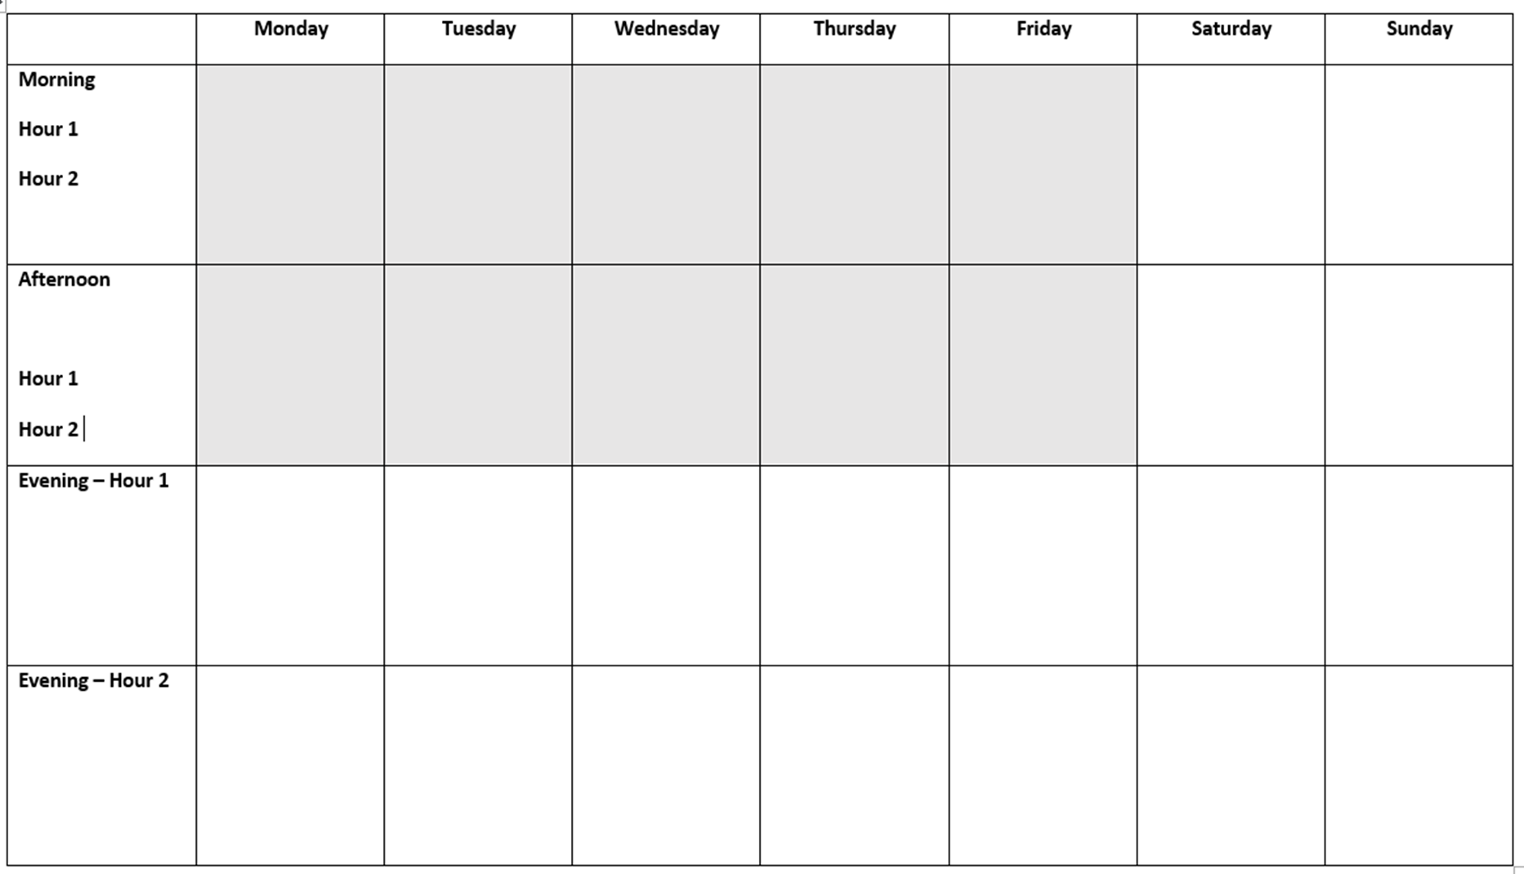
Carleton High School
Where it all begins….
Why have one? Subjects and topics
Chunk your time
Don’t ignore commitments
Notes:
Give info to parents about how students have been asked to complete this (will be a reminder to students also)
Use exam timetable – upcoming mocks , actual exam timetable (given out tonight)
Pick topics you struggle with first. Students should be able to make a list. Specificity is key.
Plan revision sessions into manageable chunks – e.g. 2 lots of 20 mins with a break of 20 mins in between.
Plan revision for the morning and afternoon at the weekend. But also factor in time for relaxing, eating, activities with family/ friends.
Space revision of the same topic apart – spaced practice is scientifically proven to aid memory recall.
Students have access to these revision schedules their tutor group bases. They can create new ones each week once they feel they need to update the areas they need to study.
Encourage your son/ daughter to stick these up somewhere at home where everyone can see so it becomes part of daily discussion.

Slide 5
Carleton High School
Where it all begins….
No
Distractions
Notes:
Keep their mobile phone – they don’t need them for revision.
20 mins work, 5 min break (with phone) 2nd set of 20 min revision (break with phone) final set of 20 mins.

Slide 6
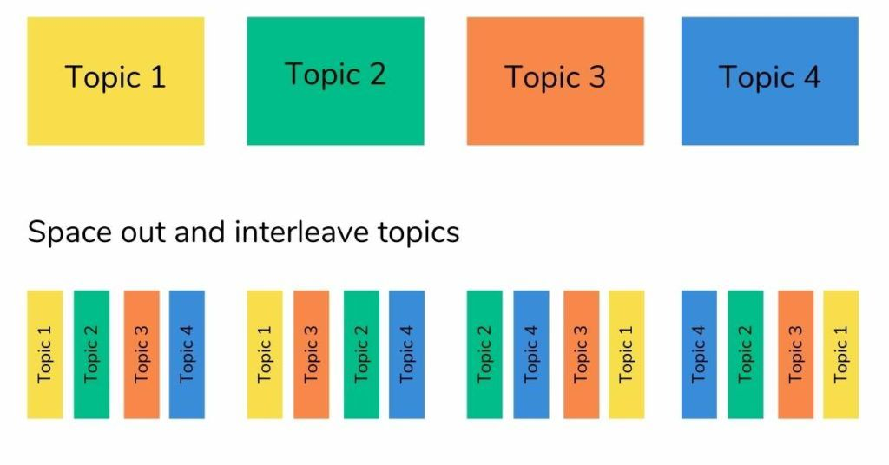
Carleton High School

Slide 7
Carleton High School
Getting them motivated
Time frames – keep the end in sight
Remove distractions
Rewards and incentives
Target grades and mock grades
Create the space
Celebrate
Talk futures

Slide 8
Carleton High School
Quizzing
Past Papers
Mnemonics
Graphic Organisers
Flashcards
Notes:
Briefly outline what revision support students have already received – the ‘mock survival guide’ and the support during tutor times with how to use these strategies. Also outline what is available in the annex for students to collect in addition to the materials provided today.

Slide 10
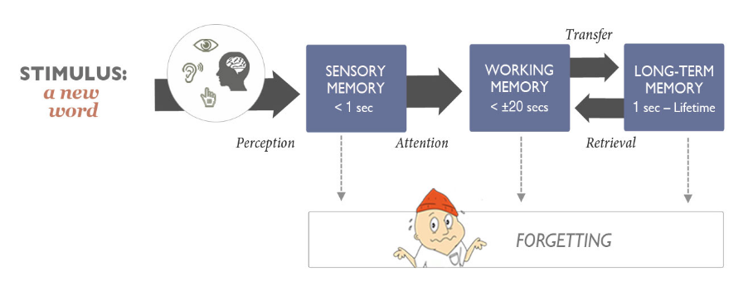
Carleton High School
2022
Sed consequat rhoncus ultricies. Suspendisse sed ullamcorper massa. Integer quis tincidunt purus. Morbi at nisi Bibendum.
Notes:
Brief discussion of science of learning – transfer of knowledge into long term memory… lead into next slide – retrieval strategies/ importance of quizzing.

Slide 11
I am now going to ask you 7 questions…
What was the hand pointing away from?
Which side did the apple have a bite out of?
Which digit was in a different font?
What time was on the clock?
What were the four numbers?
Was the elephant African (large ears) or Asian (small ears)?
Was the light bulb lit or not?
Simply looking at information/reading it will not transfer into our long term memory for us to use & apply to questions

Slide 12
Testing, testing
Carleton High School
Volunteer your services for testing on a regular basis
Get them to ‘teach’ you a topic so that you understand it and use their notes/ flashcards to check they’ve included everything
Use flashcards with them – questions/ key topics on the front and answers or content on the back.
Use exam papers and exam board websites. Support your child in tackling exam papers, marking the paper, picking out ‘learning gaps’ and then revising the topics they need to be more successful next time.
Exam condition.

Slide 13
Carleton High School
What about exam stress?
Positivity & Perspective
Healthy body, healthy mind
Revision planning
Keep in contact with us
2022
Feeling some stress is normal

Slide 14
Carleton High School
Exam ready
A
B
C
The night before
On the day
After each exam
Light revision
Check the times for exam booster sessions
Timings for arriving in school
Equipment check
Plenty of sleep
Avoid asking how they are feeling
Encourage breakfast (especially if this isn’t normal)
Tell them to avoid people who might talk negatively about the exam ahead.
Positivity and Perspective
Keep everything as normal as possible
Continue showing interest, supporting them and giving praise and encouragement
Keep perspective if an exam hasn’t gone to plan

Slide 15
Thanks.

